Slide 1
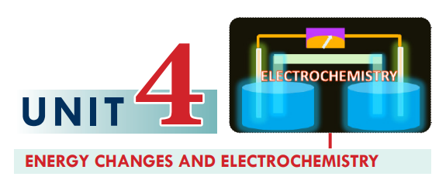

Slide 2
After completing this unit, you will be able to:
explain electrochemistry
define electrical conductivity
explain metallic conductivity
distinguish between metallic and electrolytic conduction
distinguish between weak and strong electrolytes
describe energy changes in chemical reactions;
describe how a chemical reaction produces electric current and how electricity
brings about a chemical reaction in electrochemical cells;
develop skills in writing the oxidation half-reaction, reduction half-reaction
and cell reaction for the electrolysis of molten electrolytes that occur in electrolytic cells;
describe the three types of Voltaic cells;
explain the difference between electrolytic cells and voltaic cells and
demonstrate scientific inquiry skills: observing, classifying, comparing and
contrasting, inferring, predicting, communicating, measuring, asking questions,

Slide 3
4.1. Electrochemistry: is a field of chemistry that deals with the interconversion of electrical energy and chemical energy.
Electrochemistry: studies how chemical reactions produce electricity and how electricity is used to bring about chemical reactions in electrochemical cells.
The devices that convert chemical energy to electrical energy or electrical energy to chemical energy are called electrochemical cells.
These cells can be classified as:
electrolytic cells and galvanic or voltaic cells.

Slide 4
Electrical conductivity: is the capacity of a substance to transmit electricity.
The materials that allow the passage of electricity through them are called electrical conductors. Eg Ag(silver)best.
Conductivity apparatus: is used to test the conductivity of the substance.

Slide 5
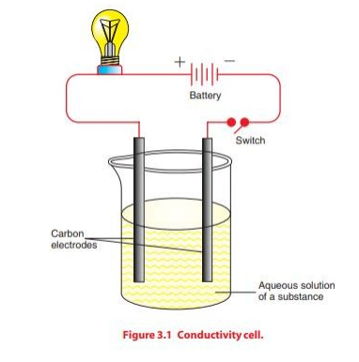
The components of the apparatus are:

Slide 6
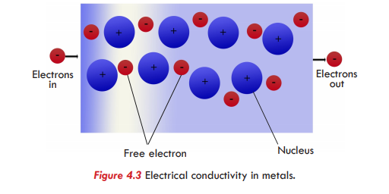
Electrical conductivity: is the ability of substances to conduct electricity.
It can be classified as metallic conductivity or electrolytic conductivity.
A. Metallic conductivity
Metallic conductivity refers to the transmission of electric current through metals.
because metals have free electrons or mobile electrons or delocalized electrons.
The charge carriers in metallic conduction are electrons.
Hence, metallic conductivity is also called electronic conductivity.

Slide 7
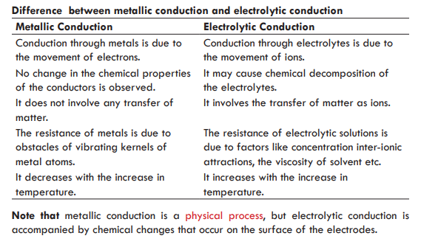
B. Electrolytic conductivity
Electrolytes are substances that transmit electricity in a molten state or in aqueous solution.
Based on their degree of ionization or the extent to which they produce anions and captions, electrolytes can be classified as strong electrolytes or weak electrolytes.

Slide 8
Strong electrolytes: ionize almost completely in aqueous solutions.
Strong electrolytes: ionize almost completely in aqueous solutions.
Example: Strong acid and Strong base
Weak electrolytes: ionize only slightly in aqueous solutions.
Example: Weak acid and Weak base
When electrical potential is applied through an electrolyte solution,
The positive ions (cations)move in one direction and the negative ions (anions) move in the opposite direction.
This movement of ions through the electrolyte, brought about by the application of electricity, is called electrolytic conductivity.
Hence, the charge-carriers in electrolytic conductivity are ions. (anions and cations).
Non-electrolytes: are the substances that do not transmit electricity either in solution or in a molten state.
Example: sugar, ethanol, oil, benzene, and liquid nitrogen.

Slide 9
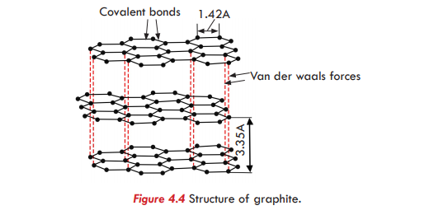
Non-metals are generally non-conductors of electricity, because they do not have freely moving electrons. Graphite: is a form of carbon in which the carbon atoms are bonded in trigonal planar fashion to the three other carbon atoms, to form inter-connected hexagonal rings, as shown in Figure 4.4. Electrons move freely through the hexagonal layers, making graphite a good conductor of electricity.

Slide 10
4.3. Electrolysis
After completing this lesson, you will be able to:
Define the term electrolysis;
Define the terms electrode, anode, cathode, electrolyte, anion and cation;
Describe an electrolytic cell;
Draw and label a diagram of an electrolytic cell;
Define the terms half-cell reaction and cell reaction;
Write the oxidation half-reaction, reduction half-reaction and cell reaction for the electrolysis of molten or fused electrolytes.

Slide 11
Electrolysis: is a process in which electrical energy is used to produce chemical changes.
This process is carried out in an electrochemical cell.
Which is electrolytic or electrolysis cell.
Electrodes: are strips of metal or graphite.
that allow electrons to leave or enter the electrolytes.
they can be chemically active or inert.
An anode: is the electrode attached to the positive terminal of a direct current source, at which oxidation (loss of electrons) by anions occurs, and electrons leave the cell.
A cathode: is the electrode attached to the negative terminal of a dc source, the negative electrode at which reduction (gain of electrons) of cations occurs and electrons enter the cell.
During electrolysis; anions move to the anode and cations move to the cathode.
The reaction taking place at each electrode (cathode or anode) is said to be a half-cell reaction.

Slide 12
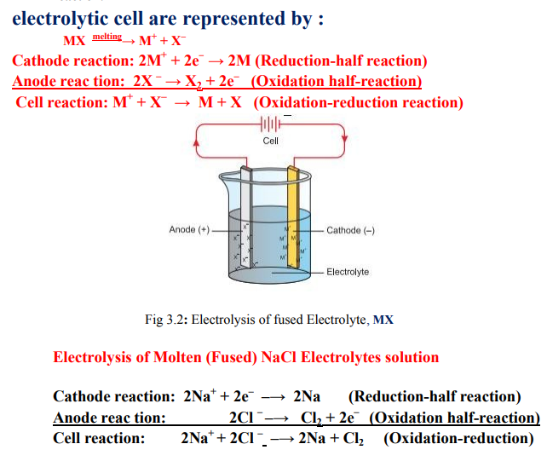

Slide 13
GALVANIC (VOLTAIC) CELLS
Definition
Voltaic (Galvanic) cells are electrochemical cells in which a spontaneous redox reaction generates electricity. They convert chemical energy into electrical energy.
Galvanic or voltaic cells are classified into
1.primary cells,
2.Secondary cells, and
3.Fuel cells.
Primary Cells; are those cells that are not rechargeable.
because the electrode reaction as well as the entire cell reaction cannot be reversed on recharging.
Examples: Daniel’s cell and zinc-carbon (Leclanche) dry cells.
The common feature
-all Galvanic cells is that they contain two electrodes in contact with an electrolyte.
The electrolyte in a Galvanic cell can be in the form of a solution (Daniell cell) or a paste (Leclanche cell).
The cells containing electrolytes in the form of solution are called wet cells, and those containing electrolytes in the form of paste are called dry cells

Slide 14
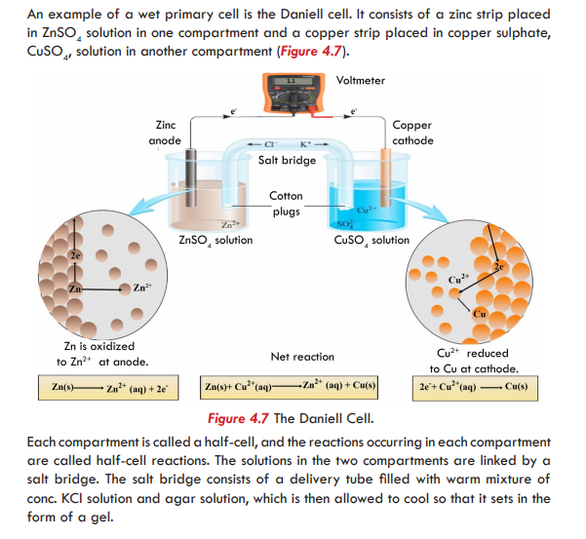

Slide 15
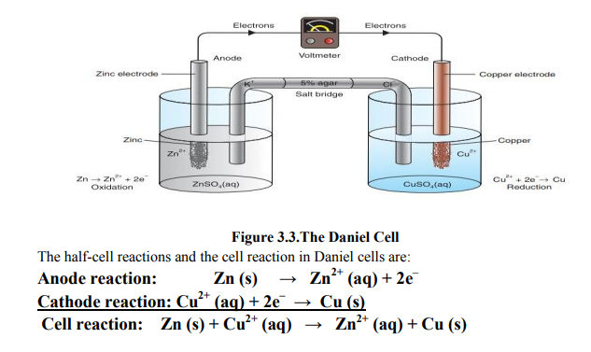

Slide 16
The reactions occurring in each compartment are called half-cell reactions.
The solutions in the two compartments are linked by a salt bridge.
The salt bridge consists of a delivery tube filled with warm mixture of conc. KCl solution and 5% agar solution,
which is then allowed to cool so that it sets in the form of a gel.
Due to the oxidation-reduction reaction in the cell, the Daniell cell generates electricity.
What is the purpose of the salt bridge in Figure 4.7? From the preceding discussion,
it is clear that the solution in which the zinc electrode is placed has an overall positive charge while the solution in the copper compartment has a negative charge.
Unless the two solutions are neutral, the cell cannot produce electricity. Thus, the purpose of the salt bridge is to maintain electrical neutrality between the two solutions.
Although, wet cells like the Daniell cell can serve as a source of electricity, they are not portable since they contain solutions. Due to this practical problem of using wet cells, dry cells were developed. In a dry cell, a moist electrolyte paste is used instead of solutions.
This cell was invented by Georges Leclanche, a French chemist.
We commonly use Leclanche cells as convenient, portable sources of energy. Flashlights and radios are examples of devices that are often powered by the zinc–carbon, or Leclanché, dry cell (Figure 4.8). This voltaic cell has a zinc can as the anode; a
graphite rod in the center, surrounded by a paste of manganese dioxide, ammonium and zinc chlorides, and carbon black, as the cathode. It produces electricity as a result of a spontaneous redox reactions:

Slide 17
In the anode compartment, the zinc atoms from the zinc electrode lose two electrons
each and become zinc ions, Zn2+.
The ions enter into the solution, and the electrons remain on the electrode and flow through the external wire to the copper electrode (see anode half reaction below).
This situation causes the zinc electrode to be negative and the solution to have an overall positive charge.
In the process the anode (zinc) electrode loses its mass.
That is why the anode of the galvanic cell is sometimes called sacrificial electrode.
On the other hand, in the compartment containing the copper electrode, copper ions, Cu2+, from the solution move to the cathode and gain two
electrons each, to become copper atoms and deposit on the surface of the copper electrode (see cathode half reaction below).
This condition causes the electrode to be positive and the solution to have a negative charge.
In addition, the cathode continuous to grow in mass as more and more copper deposits on it.
The electron flows from anode to cathode in the external conductor.

Slide 18
We commonly use Leclanche cells as convenient, portable sources of energy. Flashlights and radios are examples of devices that are often powered by the zinc–carbon, or Leclanché, dry cell (Figure 4.8).
This voltaic cell has a zinc can as the anode; a graphite rod in the center, surrounded by a paste of manganese dioxide, ammonium and zinc chlorides, and carbon black, as the cathode. It produces electricity as a result of a spontaneous redox reactions:
Anode reaction: Zn(s) → Zn2+(aq) + 2e-
Cathode reaction: 2NH4+(aq)+2MnO2(s)+2e-→Mn2O3(s)+H2O(l) +2NH3(aq)
Overall (cell) reaction: Zn(s)+2NH4+(aq)+2MnO2(s)→Zn2+(aq)+Mn2O3(s)+H2O(l) + 2NH3(aq)

Slide 19
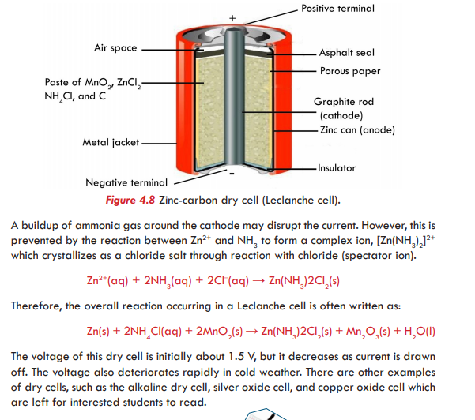

Slide 20
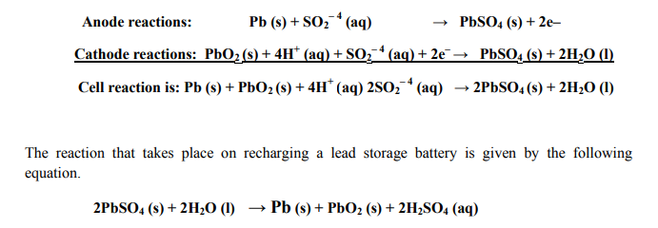
B. Secondary Cells
Secondary cells are voltaic cells that are rechargeable since the reactions taking place
in them are reversible. Example; Lead Storage Battery
A single lead-storage cell delivers 2 volts.
Therefore, a 12 V battery contains six cells connected in series.
When a lead-storage battery is in operation (on discharge), the following reactions
occur at the electrodes:

Slide 21
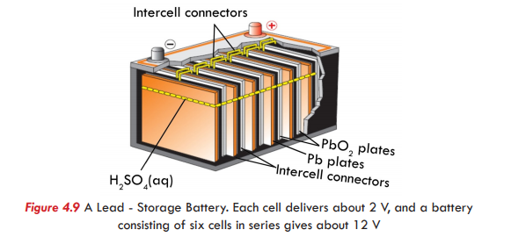
A lead storage battery is the
common automobile battery that usually delivers either 6 or 12 volts, depending on the number of cells used in its construction.
The inside of this Voltaic cell consists of electrodes of lead alloy grids; one electrode is packed with a spongy lead to form the anode, and the other electrode is packed with lead (IV) oxide to form the cathode.
(see Figure 4.9). Both are bathed in an aqueous solution of 35% sulfuric acid, H2SO4.
A single lead-storage cell delivers 2 volts. Therefore, a 12 V battery contains six cells connected in series(Figure 4.9).

Slide 22
When a lead-storage battery is in operation (on discharge), the following reactions occur at the electrodes:
Anode reaction: Pb(s) + SO42-(aq) → PbSO4(s) + 2e-
Cathode reaction: PbO2(s) + 4H+(aq) + SO42-(aq) + 2e- → PbSO4(s) + 2H2O(l)
Overall (cell) reaction: Pb(s) + PbO2(s) + 4H+(aq) + 2SO42-(aq) → 2PbSO4(s) + 2H2O(l)
From the electrode reactions it can be noticed that PbSO4 is produced at both electrodes. Lead-storage battery, as a secondary cell, is rechargeable when it runs down.
The electrode reactions can be reversed by applying a potential across the electrodes that is slightly larger than that which the battery can deliver.
The reaction that takes place on recharging a lead storage battery is given by the following equation.
2PbSO4(s) + 2H2O(l) → Pb(s) + PbO2(s) + 2H2SO4(aq)
Note: The electrode that served as anode during discharging (use) is forced to behave as cathode during recharging.
Consequently, the direction of the electron flow that was from left (Pb = anode) to right (PbO2= cathode) is changed to right (PbO2= anode) to left (Pb =cathode).
Oxidation always takes place at anode and reduction at cathode. The direction of electron flow is always from anode to cathode.

Slide 23
QUESTIONS
1. What is the purpose of the salt bridge in Figure 3.3?
2. What are the differences between voltaic cells and electrolytic cells?
3. What are the differences between Primary and secondary cell?
4. A lead-storage buttery is an example of ____
a. a an electrolytic cell called secondary cell
b. a galvanic cell called secondary cell
c. a rechargeable electrolytic cell called secondary cell
d. only b and c
5. How do you know if an electrode is a cathode or an anode in voltaic cells and in electrolytic cells?
6. Can you suggest why positive and negative ions are named as cations and anions respectively?
7. Distinguish between Voltaic cells and electrolytic cells.
8. During electrolysis of fused PbBr2,
a. Which ions are responsible for the conduction of electricity through the molten salt?
b. What half-cell reactions occur at the anode and cathode?
END OF CHAPTER-4
THANK YOU

